Slide 1


Predicting Instacart Customers Purchasing Behavior (When they will make their next purchase and what products to expect in that purchase )
Data 606 –Capstone Project
(Part 4)
Thaiyalnayagi Karthik
SPRING 2020
University of Maryland Baltimore county
Notes:
Hello everyone. I am Thaiyalnayagi Karthik. Welcome to my final phase of my Capstone project presentation. The Project topic is predicting Instacart customers purchasing behavior. Lets get into the presentation

Slide 2

Agenda
Project objective
Model in delivery 3 vs model in delivery 4
Project phases
Project demo
Prediction Result Summary
Lessons learnt
Prediction Result by department
Recommendations
Future work
Conclusion
Assumptions & Interests
Notes:
First, I would like give an overview of my entire project, starting from my project objective, what are the changes I made from previous presentation and now, what are the phases I gone through and finally I will present my prediction result along with some recommendation of how to implement this project outcome to make sense in real-time and other possible approaches to this problem that might give a different result.

Slide 3
Project Objective
Prediction 1: (Customers’ next purchase)
When the customer will possibly make their next purchase
In next 15 days or
With in 30 days
Prediction 2: (Customers’ product preferences in their next purchase)
What reordered products will be there in their immediate next order
Notes:
Here I am dealing with two predictions. One is Customers next purchase, when they will make the next purchase and the other is what are the possible products in their next purchase.

Slide 4
Assumptions & Interest
Assumption
Will make next order within 30 days – based on their previous behavior
Will surely make another order – Customer Churn is not handled
Interest
Only customers’ reordered products purchase are predicted
Users new product purchase not handled or included in the prediction
Only customers who made more than 3 purchases are included – not designed to handle new customers
Notes:
I designed this model based on some assumptions and interests. Firstly, based on the inference from exploratory analysis all the customers I am handling in this model had more than 3 purchases that too within 30 days. So, I assume that they will surely make another purchase that too within 30 days. Hence, Customer churn is not handled in this model. Nextly, here I am interested only on the reordered products. That is the products the customers had reordered atleast once. New product purchase not included in the prediction. Further, this model not built to predict new customers behavior however can be used to cross check.

Slide 5
Model in delivery 3 vs Model in delivery 4 (Prediction 1)
Delivery 3
Multiclass Classification
Logistic Regression
Delivery 4
Binary Classification
XGBoost
Notes:
Next lets look at what changes I made from delivery 3 to now. In prediction 1, that is next purchase day prediction, I classified customers into 3 classes (0-10, 11-20 and 21-30) and logistic regression model resulted in a prediction accuracy of 79%. Later when I checked with a different test data, the model performed very poor. So, I rechecked my model and found that I am using some traces of the label which I am about to predict in my features in the RFM segmentation. When I corrected it, the model’s performance totally changed and seem to perform very poor only offering a F1 score of 55% in each class. So, I changed my model into a binary classification model, classifying user purchase interval as less than 15 days and more than 15 days to 30 days, to make prediction sensible and useful for implementation. Then with creating appropriate features, XGBoost Classifier seem to perform better offering a overall accuracy and F1 score of 70%. This is the main difference. Apart from that I performed some non-linear feature transformations and scaling in order to increase the accuracy of prediction.
Also removed some outliers where few customers purchased 100 products at a time and total orders seems to be higher than visit duration.

Slide 6
Project Phases
Loading and Exploring Data
Data Cleaning
Data Preparation
Model Building
Prediction
Evaluating and selecting Model
Feature Selection and Model Tuning
Executing and Evaluating model
Interpretation
Collect data and decide goal
Notes:
Coming to the project phases, I started from collecting data, decided the project objective and then loaded the data and explored the data using Tableau. Based on the exploration, performed necessary data cleaning including removing outliers and extracted appropriate features for building the prediction model using Python and Spark. With data been prepared, I built my model and evaluated it. To improve accuracy, went back to data preparation, made some non linear transformation on the features and again trained the model on training data and tested with test data. Used F1 score of each class, confusion matrix and overall accuracy for prediction evaluation. Then extracted features and cross validated to check its performance and finally predicted and interpreted.

Slide 7
Project Demo
Notes:
Lets have a glance at the code now.

Slide 8
Prediction Result Summary
Prediction 1: When user will make next purchase? (Binary classification)
Best algorithm: XGBoostingClassifier
Training Accuracy: 0.70
Test Accuracy: 0.70
F-measure: 0(0.70), 1(0.70)
Prediction 2: What products previously purchased by user will be in next/upcoming order (Binary classification)
Best algorithm: XGBoostingClassifier
Training Accuracy: 0.72
Test Accuracy: 0.71
F-measure: 0(0.80),1(0.51)
Recall: 0(0.70), 1(0.70)
Recall: 0(0.75), 1(0.61)
Notes:
This is the prediction result summary. I hope I explained it while going through the code. So, lets move on to see how the model can be interpreted.

Slide 9
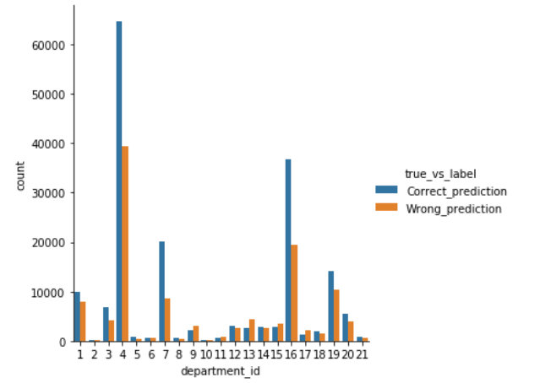
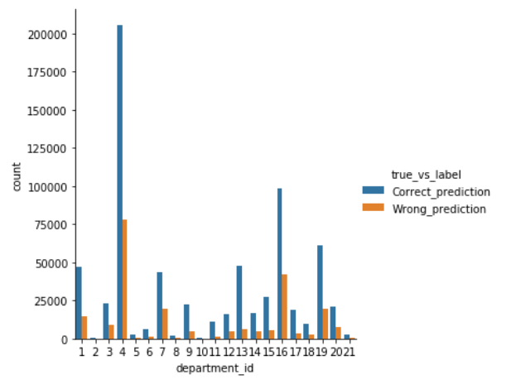
Prediction Result by department
Buying a product prediction
Not buying a product prediction
Notes:
Here I have plotted department wise correctly predicted values and wrongly predicted values for buying a product and not buying a product respectively.
The left side graph (buying a product prediction) clearly shows that the model performs well on few departments compared to another. In few departments such as 4, 7,16,3, 20 the model seems to correctly identify the products the user going to purchase compared to the false predictions. Hence implementing the model initially on these departments would give good results. On the other hand the graph on the right, the model seems to perform very well on all departments on identifying products the users will not purchase.

Slide 10
Recommendation
Deploy the results of the model for the departments on which the model’s performance is better
Gradually implement the model in other departments and monitor their performance
Re-run or update the model periodically to check the effect of the model in real-time
Modify the model when its performance diminishes
Notes:
Overall, my recommendation on implementing this model would be start deploying the results of the model for the departments on which the model’s performance is better. Gradually apply it to other department and verify. Further, once deployed it is necessary to monitor the models performance, as there is a chance for the model performance to diminish due to various external factors like competitions, customers’ change of preference and so on.

Slide 11

Future Work
Clustering the customers based on their product preferences and running a model for each cluster to make prediction
Transfer learning
Notes:
As far, I explained about what I did. Now I would like to discuss on what are the other possible ways to approach this problem. One is the customers can be clustered based on their product purchases and building separate models for each cluster and predicting. Another choice is transfer learning. I tried with RFM segmentation of customers and predicting on different segmentation. But it didn’t work well and also I tried giving weight based user product reorder rate but behaved similar to be given as a feature so I used it as one of the features in my model. Trying the above approaches hopefully might give a different result.

Slide 12
Lessons Learnt
Segregate the label before performing feature transformation
Perform oversampling only on training data
Try the model with different test set to ensure consistency of the model
Explain the assumptions and limitation of the model to the decision maker
Notes:
Moreover, I would like to share some of the lessons learnt from this project. First, segregate the label before performing feature transformation. As I said in one of my slides, there is a chance of using the label in the training set in the features which will fit very well on the training data but performs poorly on a different test data. So, when building a model go one or two steps past and try to make predictions. Next, always oversample the data after splitting the data into train and test. Performing oversampling even on test data, will overfit the model and will not work for new data as the model did not generalize much. Lastly, explain the assumptions and limitation of the model to the business user for better decision making.

Slide 13
Conclusion
This project
Studied the Instacart customers’ purchasing behavior
Predicted customers’ next purchase
Predicted customers’ possible product choices in their next purchase
Tried to balance between buying products and non-buying products for better stock management decisions.
Notes:
To conclude, Overall, this project basically studied the behavior pattern of Instacart customers and predicted their next purchase interval and product choices in their next purchase with around 70% accuracy. Further it tried to balance between the buying products and non-buying products for better stock management decisions.

